Slide 1




UNIVERSAL INTELLIGENT PARKING

Slide 2
Main Functionality of Back Office Tool
UNIVERSAL INTELLIGENT PARKING
￼

Slide 3
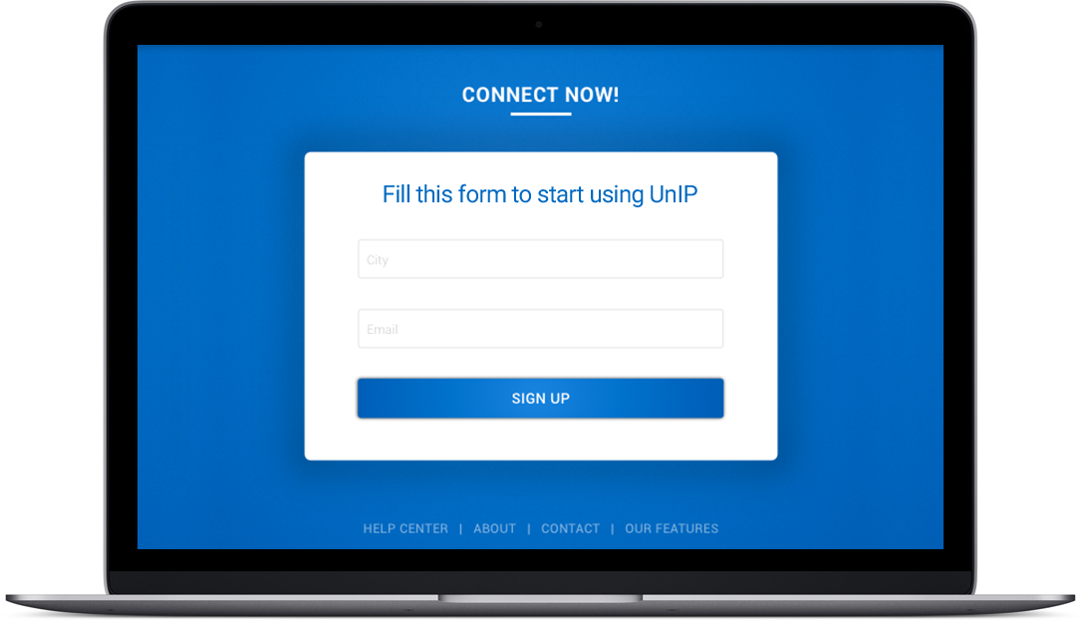
Registration
Main Functionality of Back Office Tool
Convenient and simple registration
Intuitive interface
UNIVERSAL INTELLIGENT PARKING
￼

Slide 4

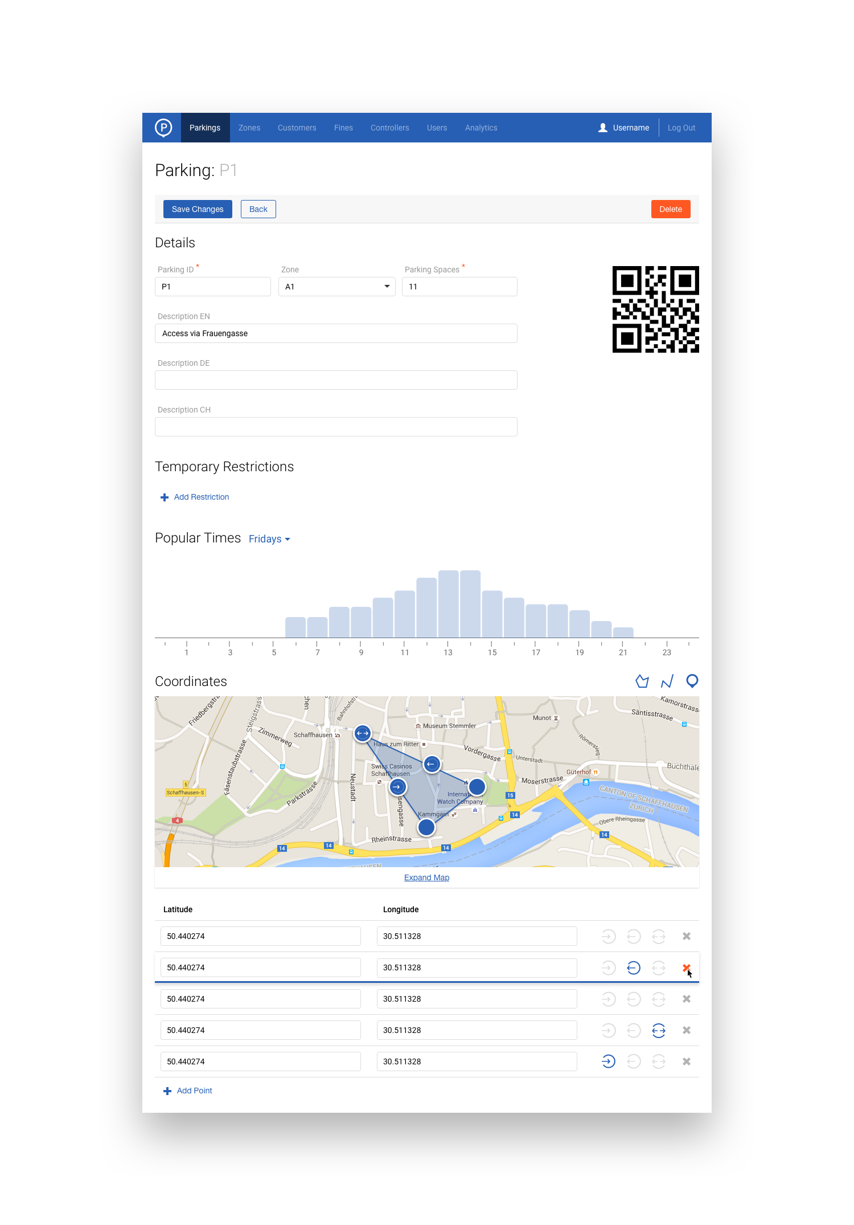
Maps
Main Functionality of Back Office Tool
Simple and convenient method to add all different types (on-street, off-street, garage) of parking on map
UNIVERSAL INTELLIGENT PARKING
￼

Slide 5
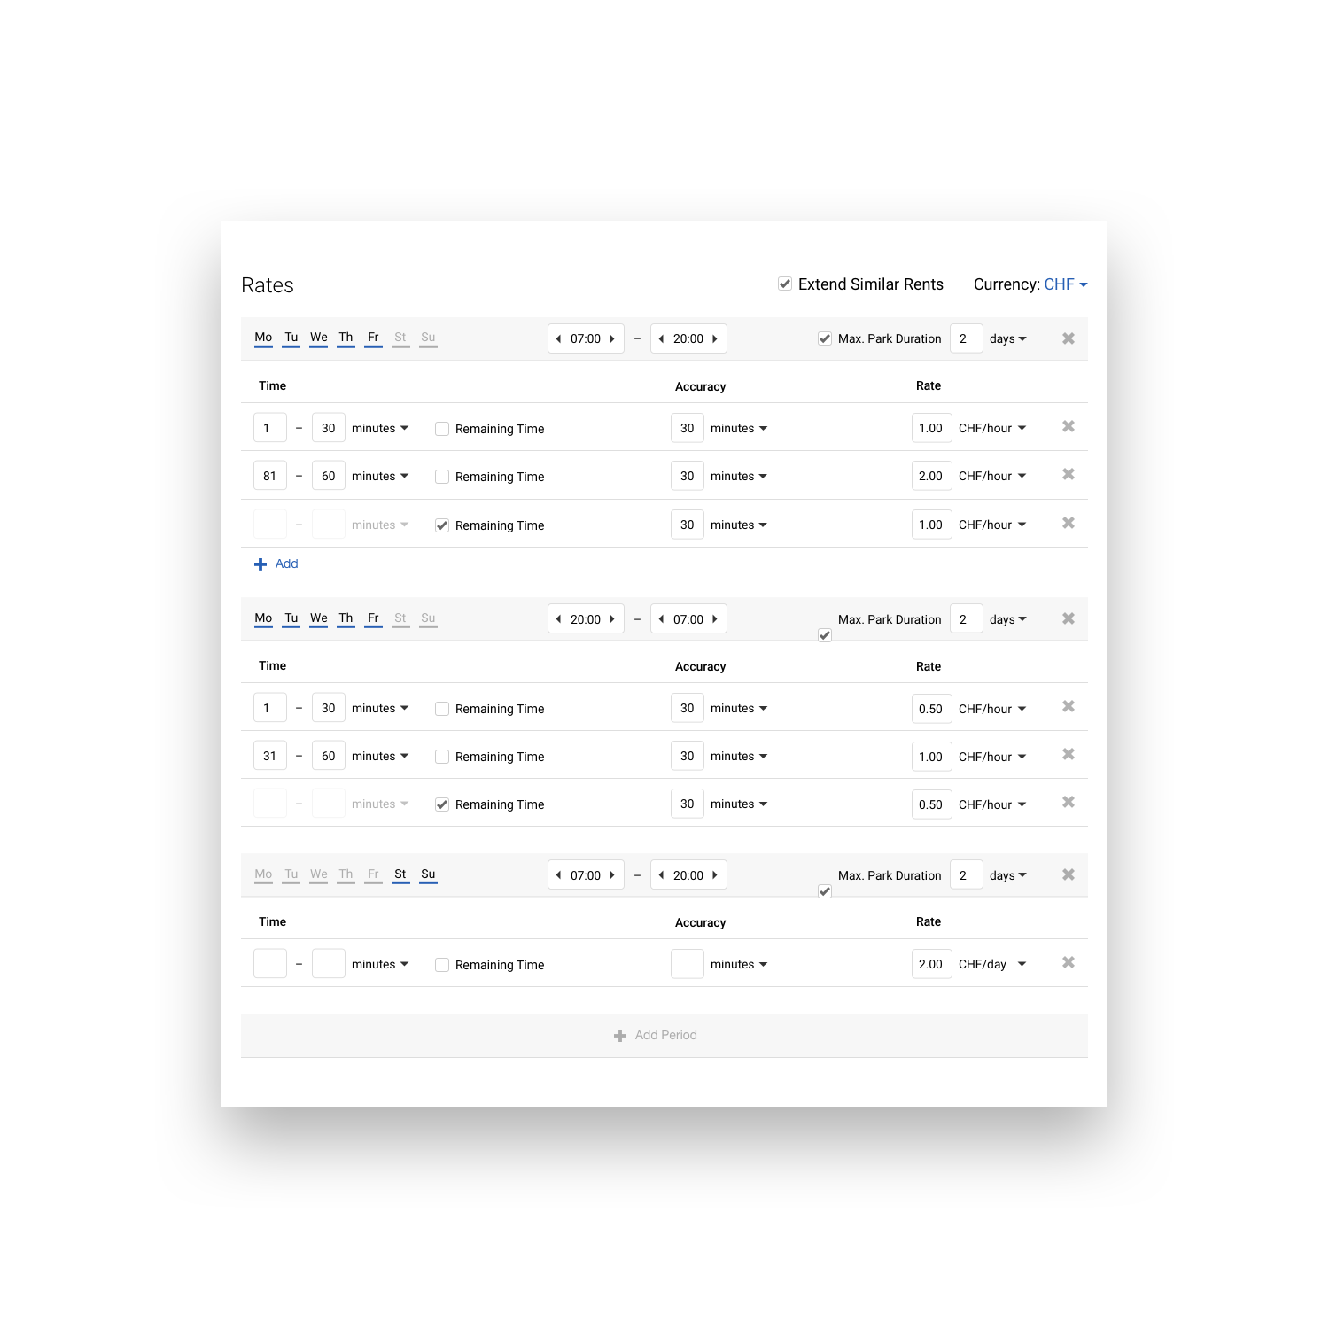
Rates
Main Functionality of Back Office Tool
Create your own rate and use predefined ones
Change prices remotely to improve monetization and parking loading
UNIVERSAL INTELLIGENT PARKING
￼

Slide 6
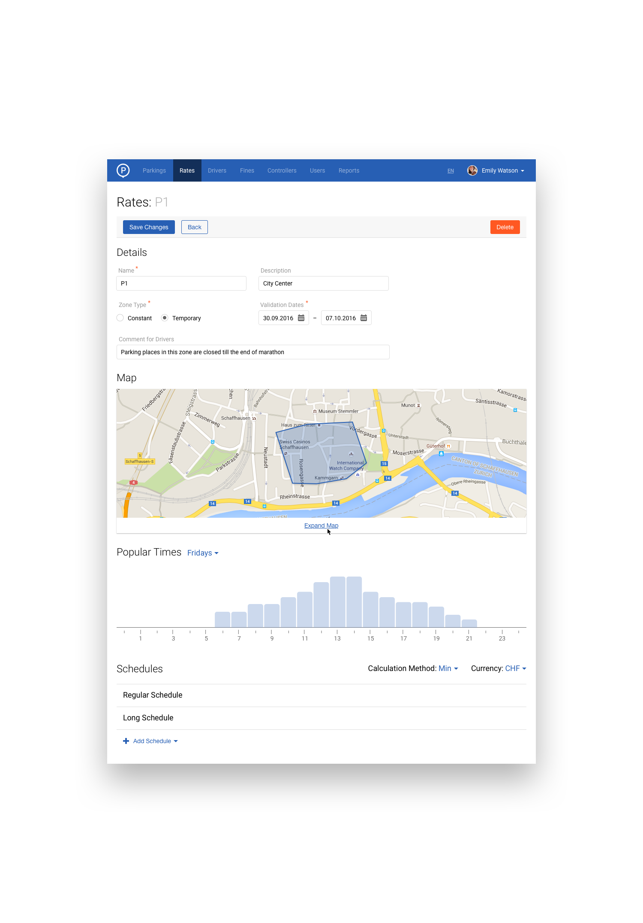
Zones
Main Functionality of Back Office Tool
Draw parking zones and define schedules for temporary parking restrictions
UNIVERSAL INTELLIGENT PARKING
￼

Slide 7
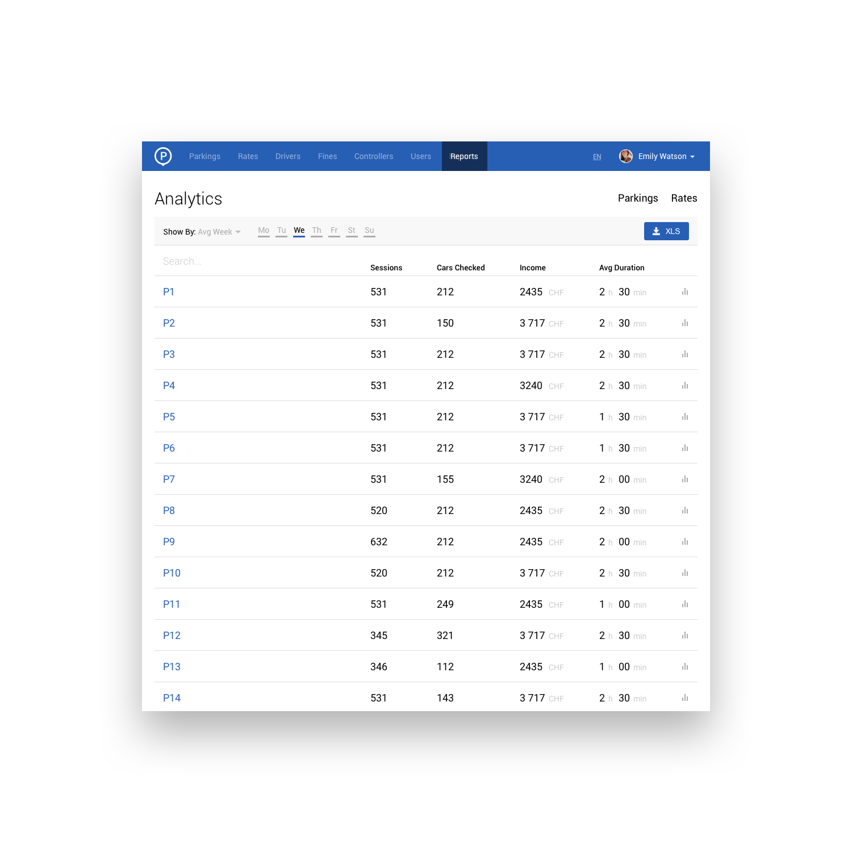
Statistics and Reports
Main Functionality of Back Office Tool
View detail reports about parking sessions based week days or other parameters
UNIVERSAL INTELLIGENT PARKING
￼

Slide 8
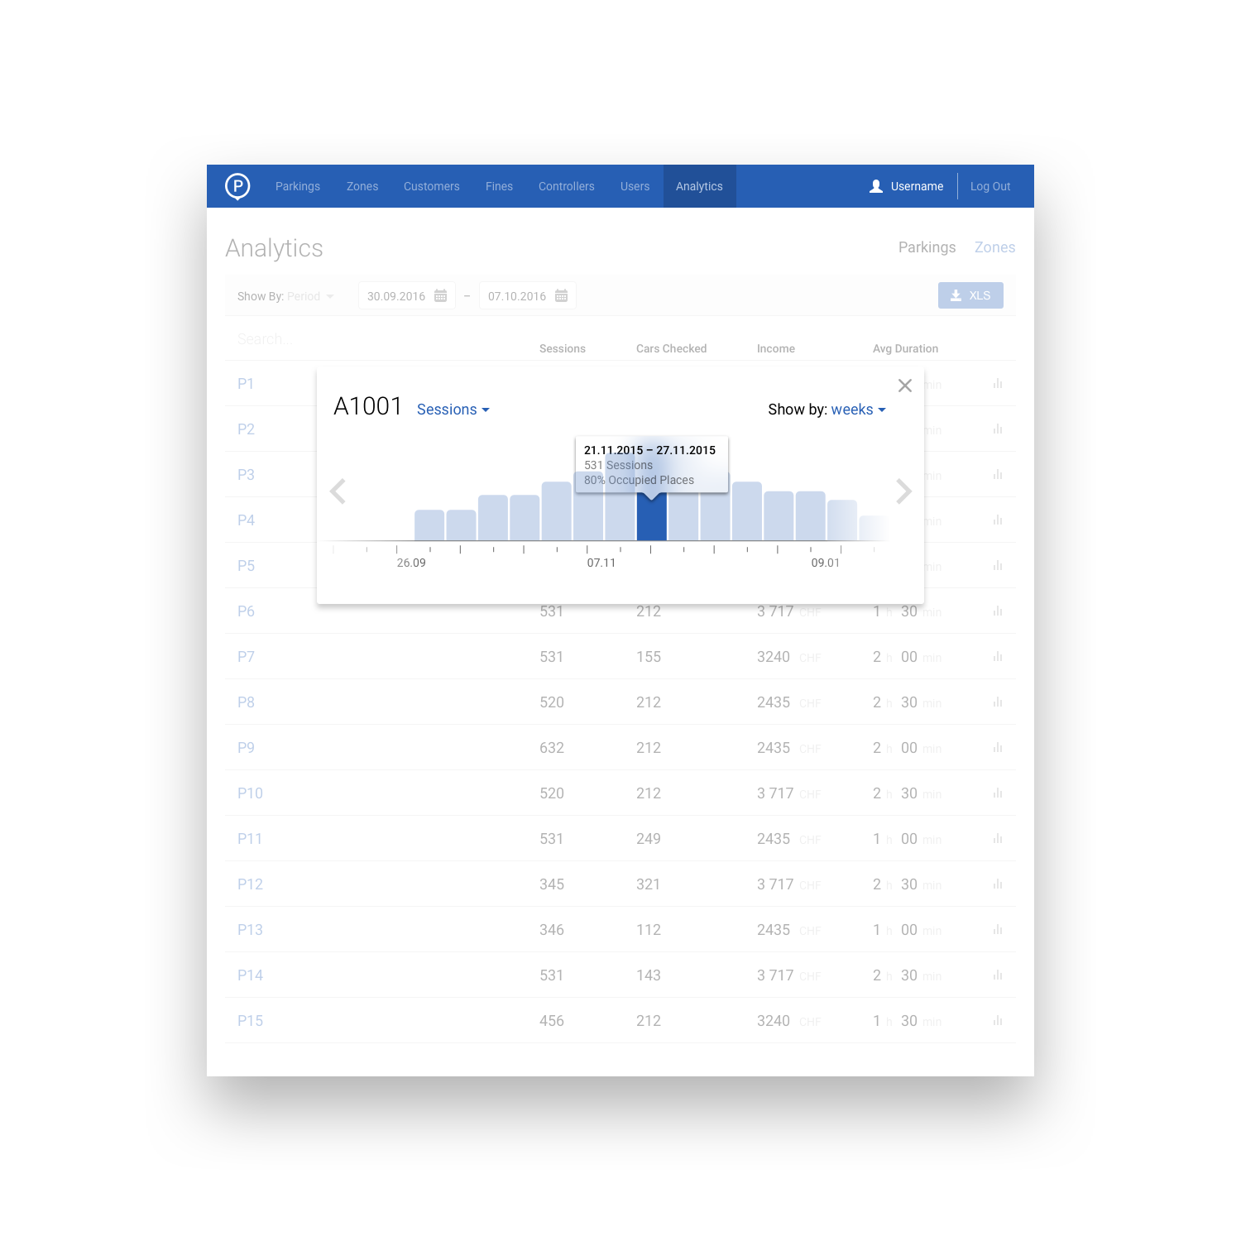
Statistics and Reports
Main Functionality of Back Office Tool
Analysis of the parking space occupancy and development of proper parking solutions with regard to dynamic fare, parking time, etc
UNIVERSAL INTELLIGENT PARKING
￼

Slide 9
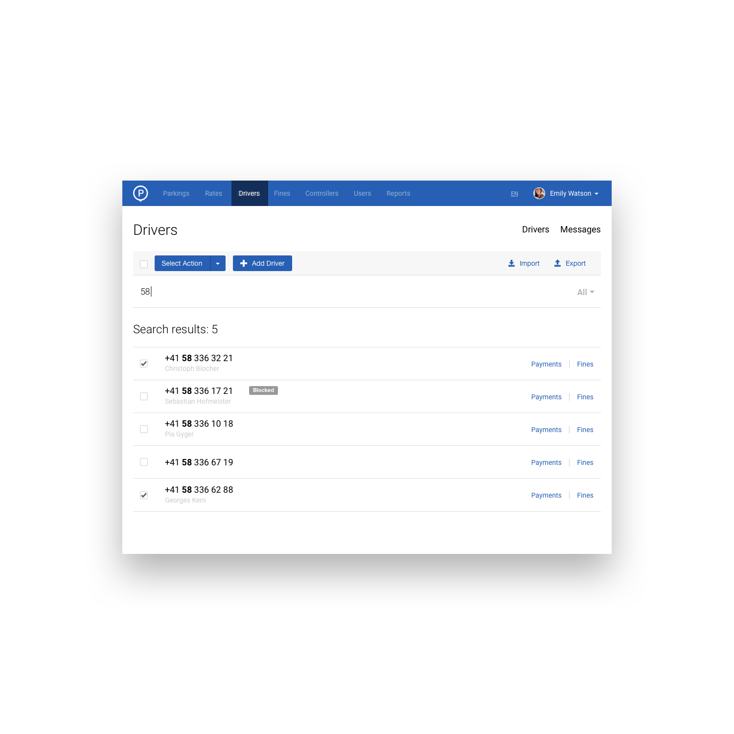
Customer management
Main Functionality of Back Office Tool
Direct access to drivers' data base
UNIVERSAL INTELLIGENT PARKING
￼

Slide 10
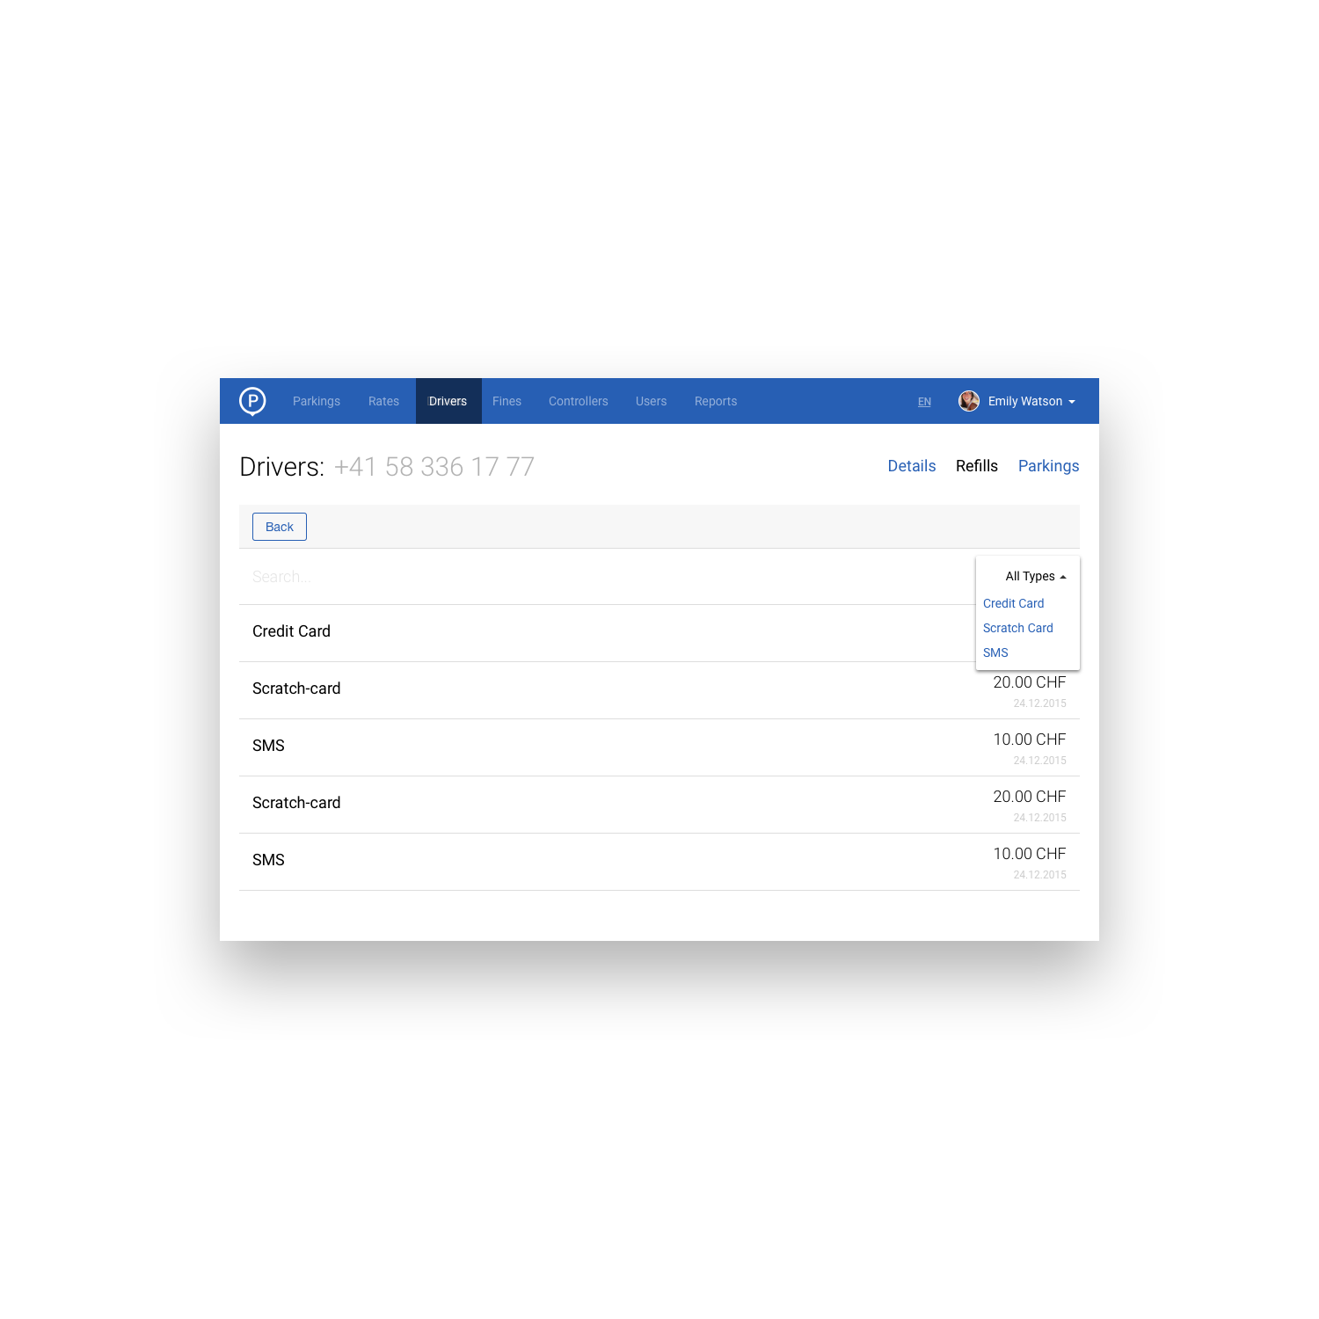
Customer management
Main Functionality of Back Office Tool
Full flow of funds information
UNIVERSAL INTELLIGENT PARKING
￼

Slide 11
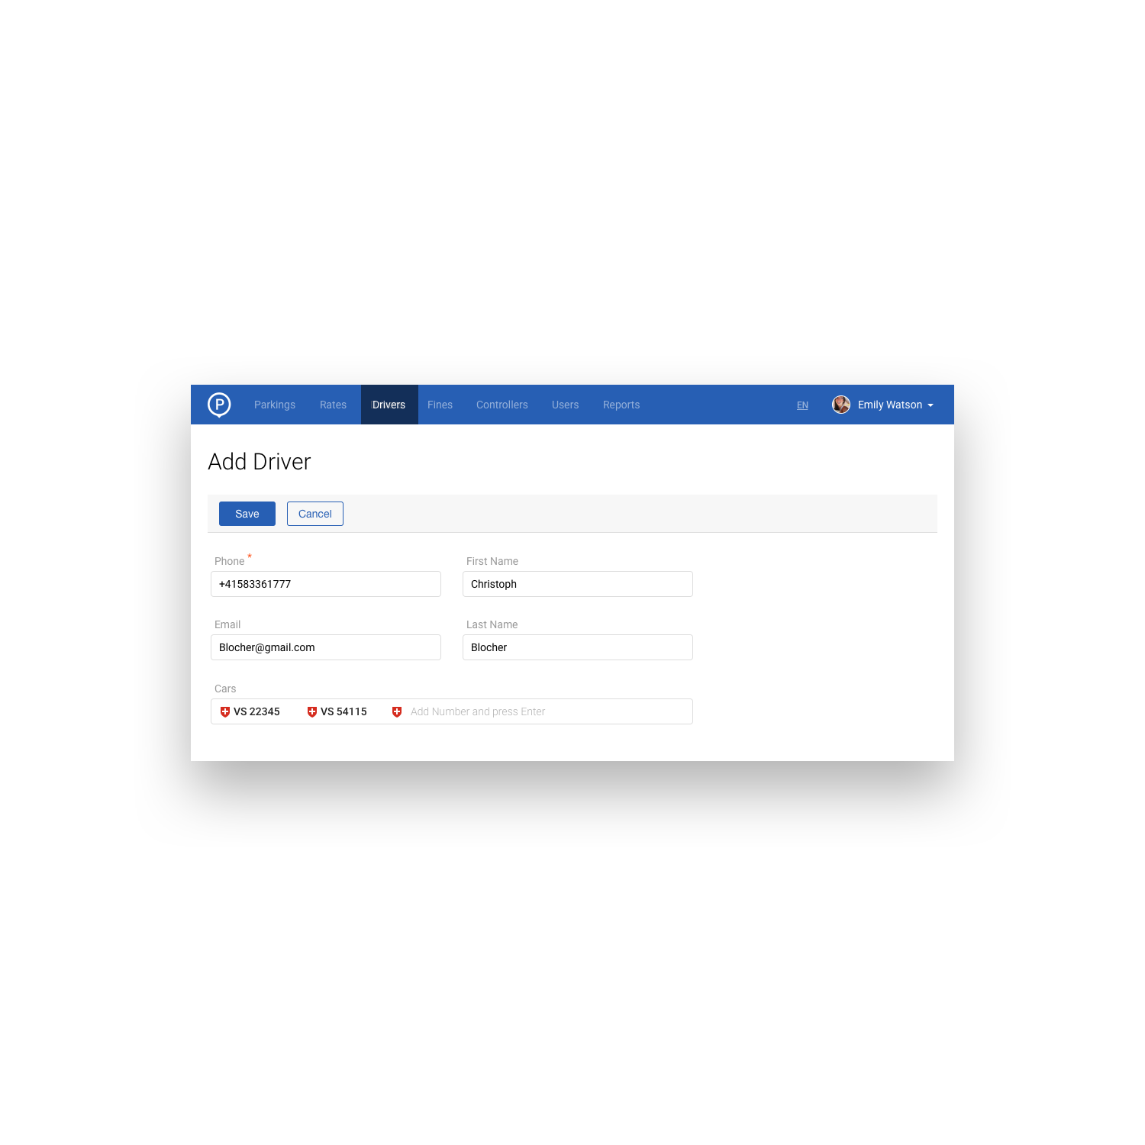
Customer management
Main Functionality of Back Office Tool
Manual driver creation via Helpdesk
UNIVERSAL INTELLIGENT PARKING
￼

Slide 12
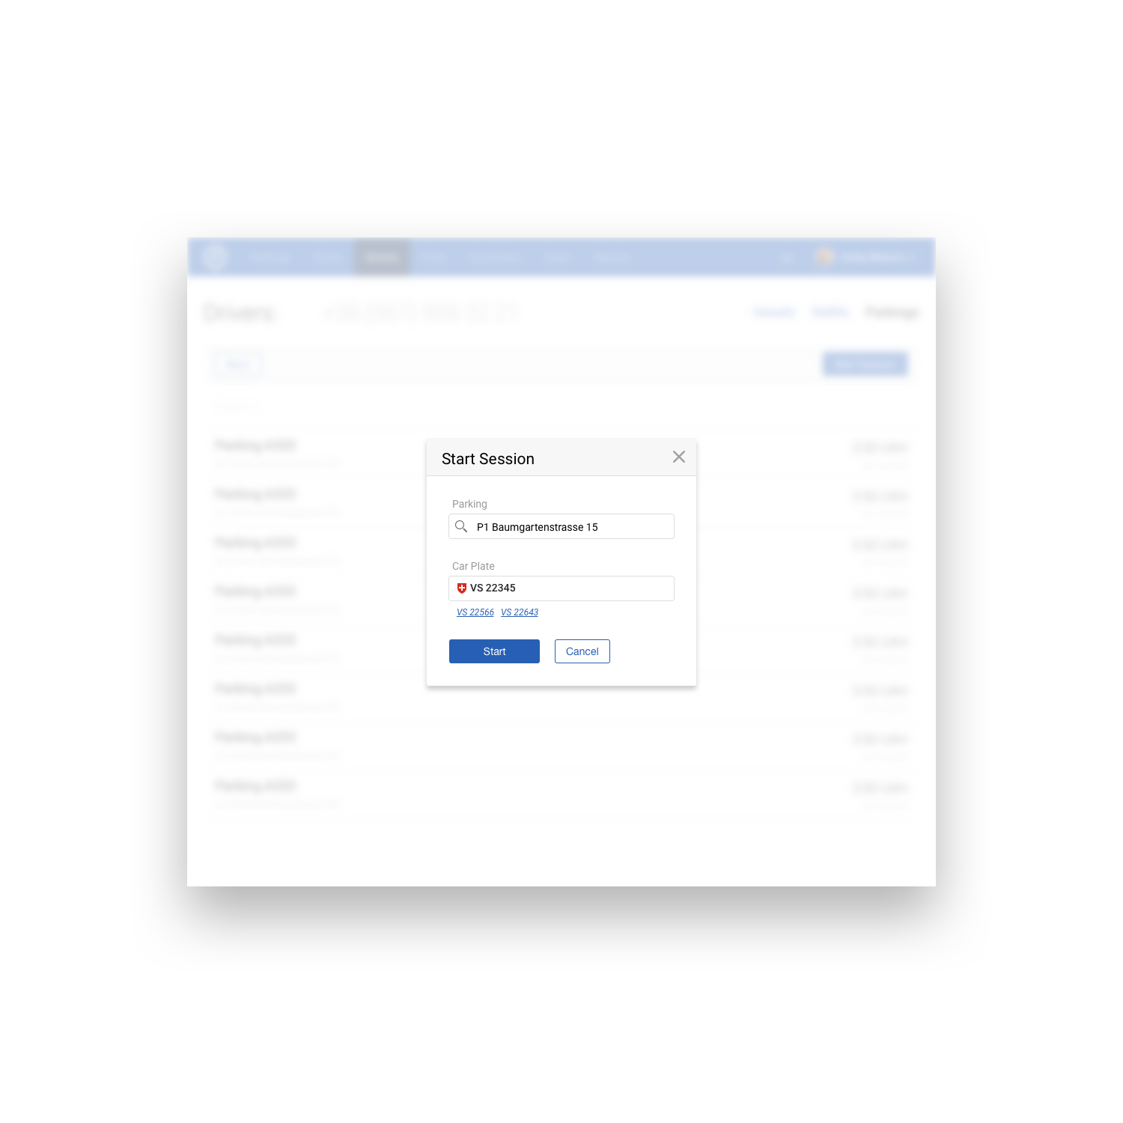
Customer management
Main Functionality of Back Office Tool
Manage parking sessions for particular drivers via Helpdesk
UNIVERSAL INTELLIGENT PARKING
￼

Slide 13
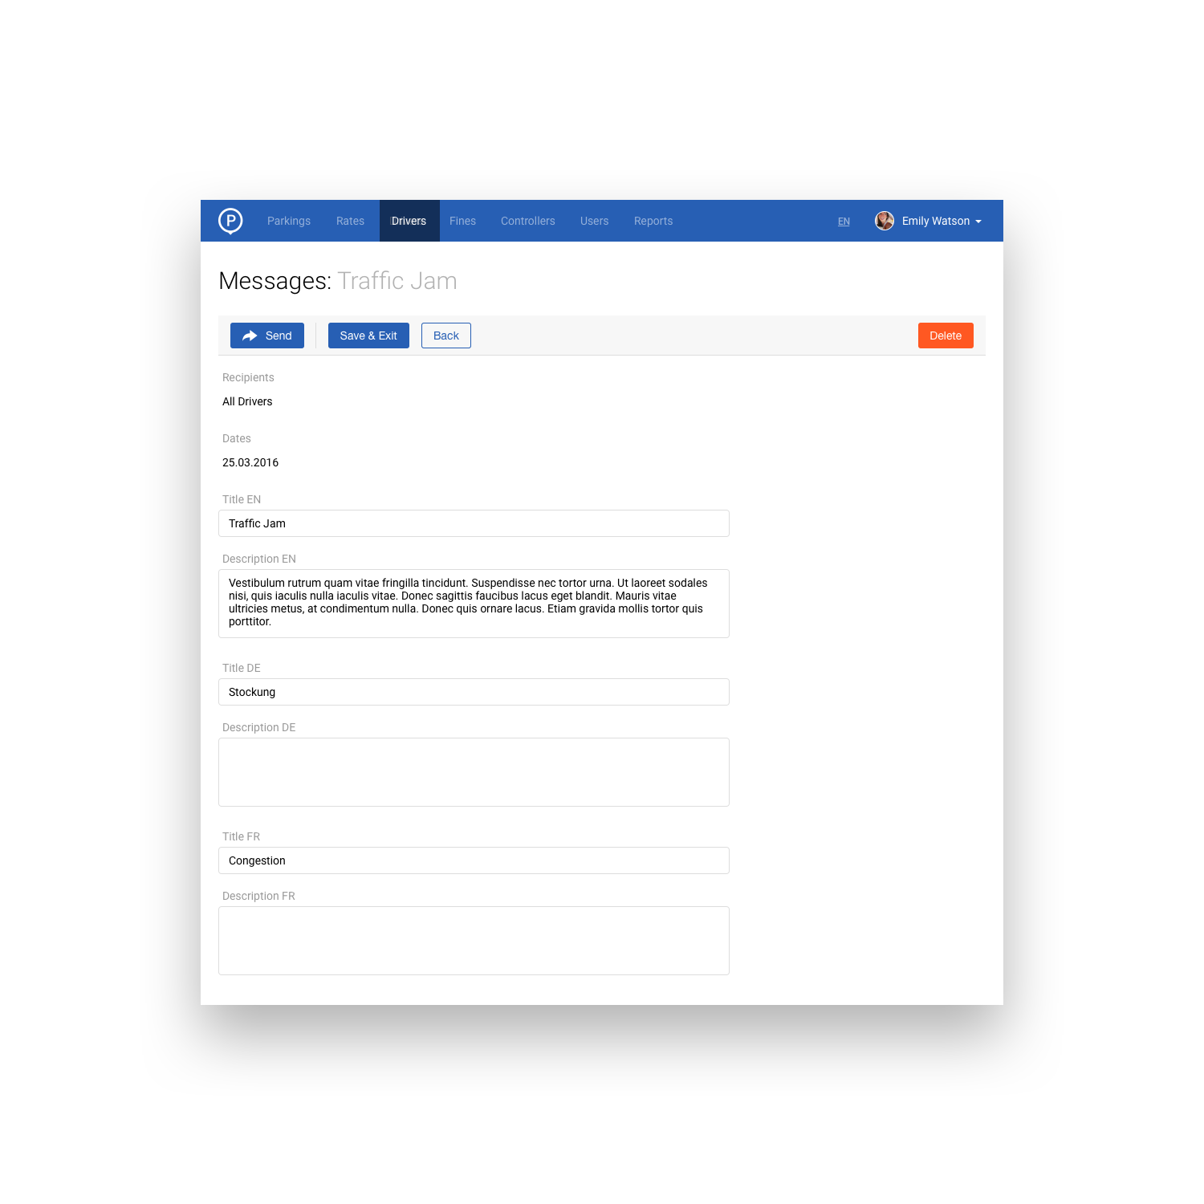
Customer management
Main Functionality of Back Office Tool
Create and send notifications to particular drivers
UNIVERSAL INTELLIGENT PARKING
￼

Slide 14
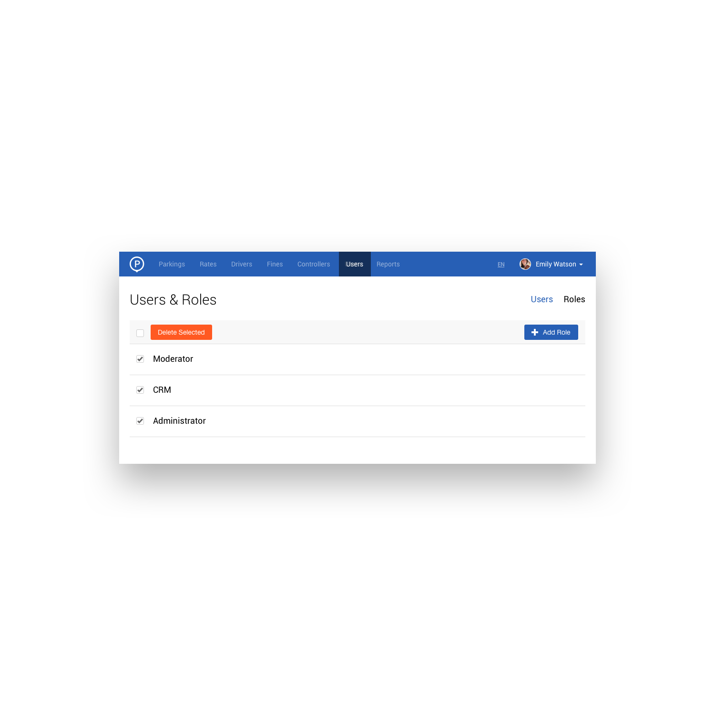
Management of users
Main Functionality of Back Office Tool
Create roles for all team members
UNIVERSAL INTELLIGENT PARKING
￼

Slide 15
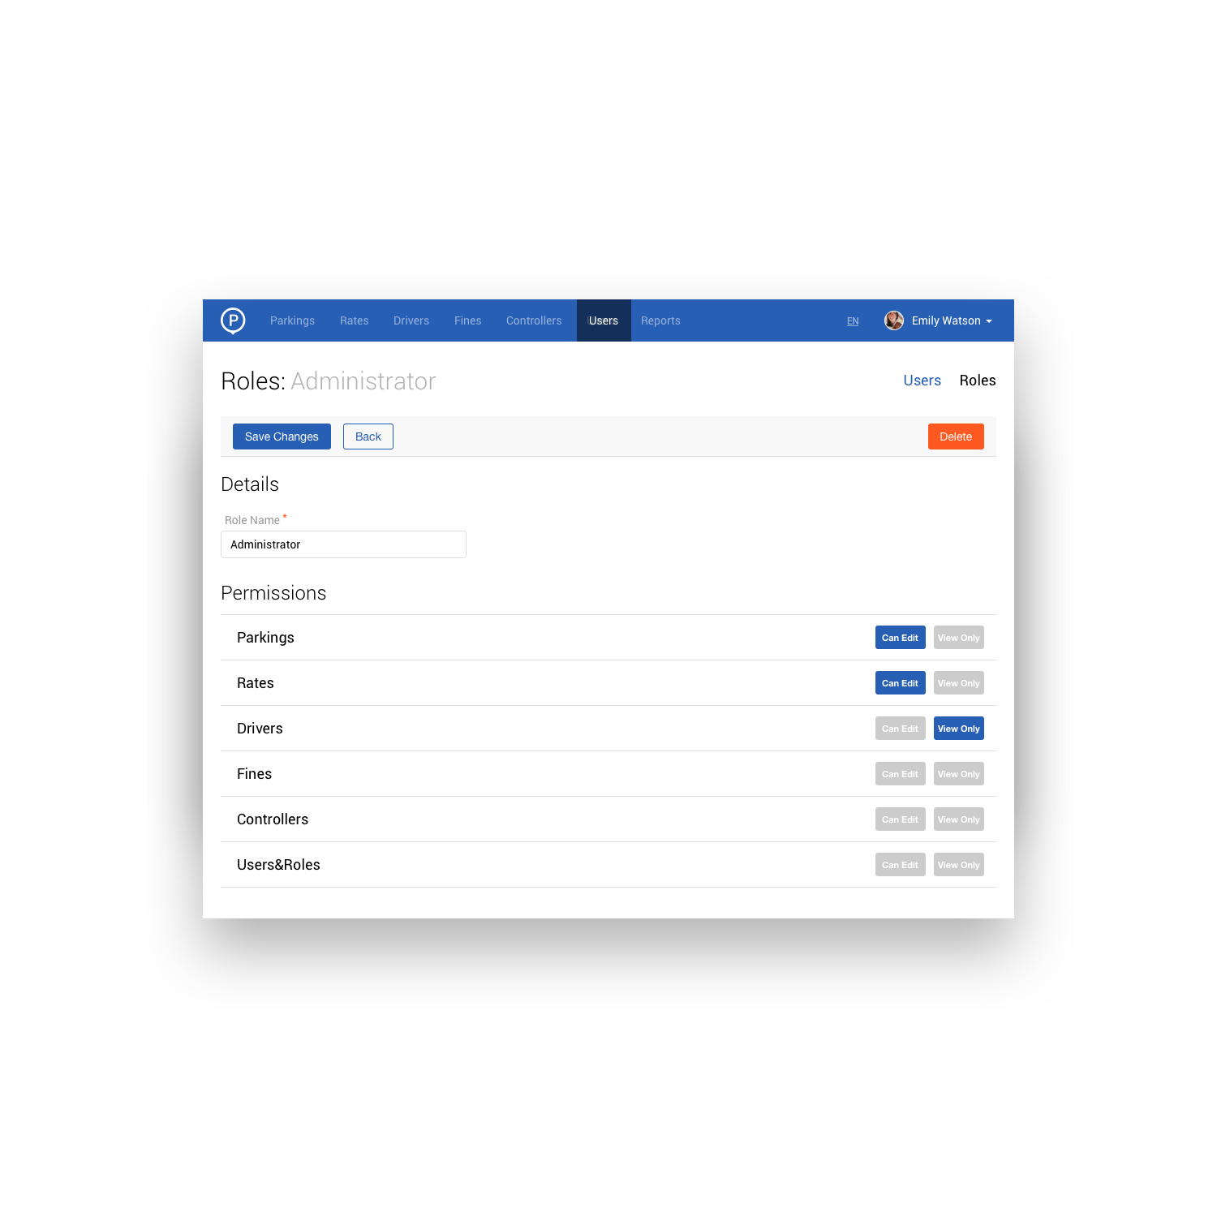
Management of users
Main Functionality of Back Office Tool
Define permissions for each user role
UNIVERSAL INTELLIGENT PARKING
￼

Slide 16
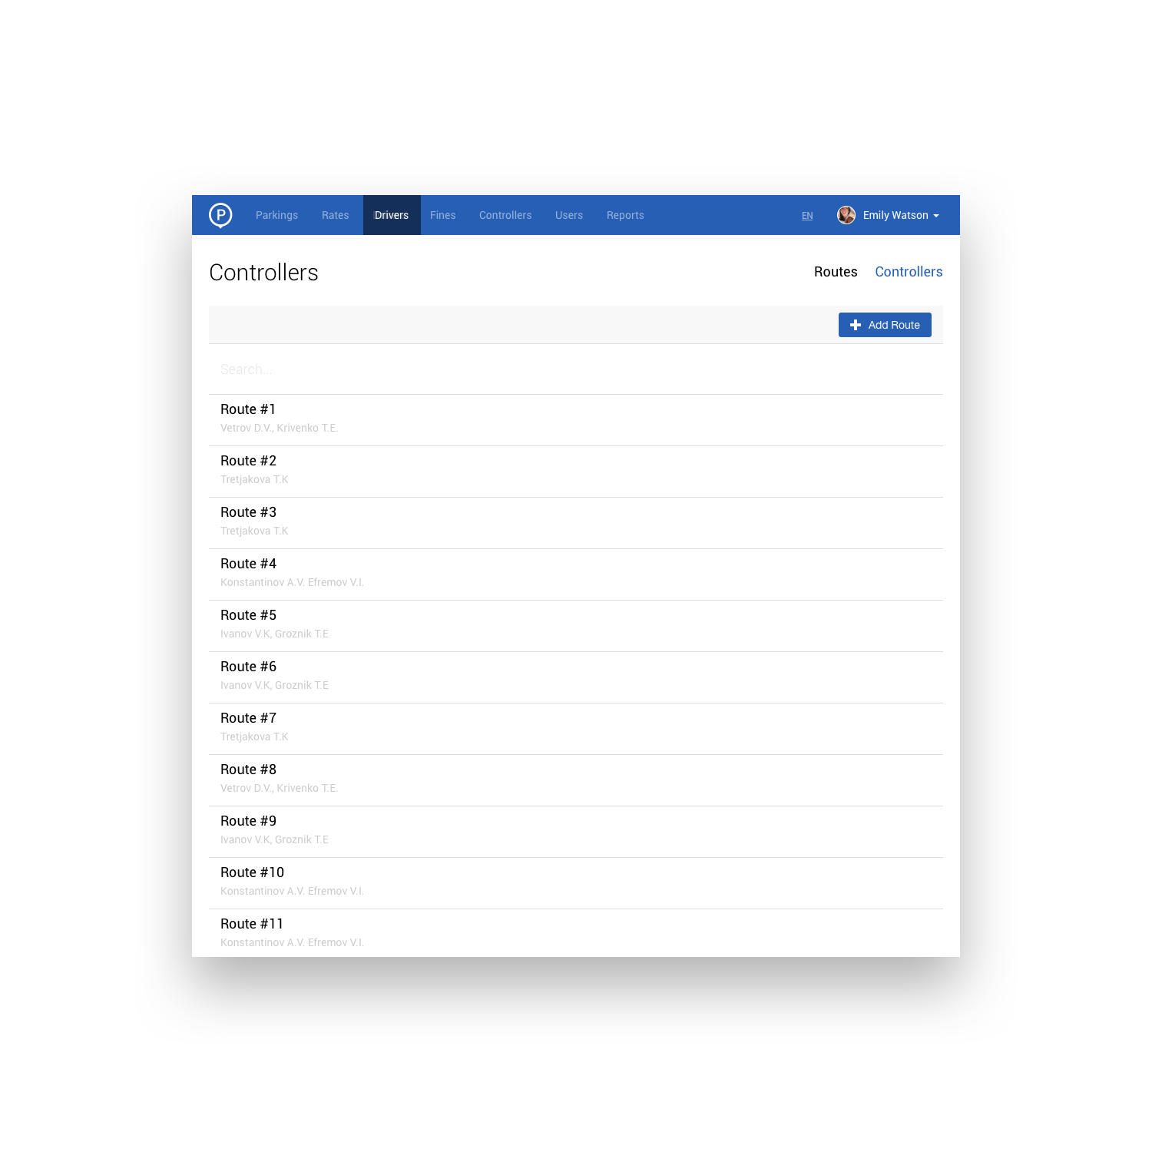
Management of users
Main Functionality of Back Office Tool
Manage controller routes and schedules
UNIVERSAL INTELLIGENT PARKING
￼

Slide 17
Billing
Main Functionality of Back Office Tool
Use popular and reliable payment and top up instruments: PayPal, Google Wallet, Apple Pay, PayMaster, SMS
Monthly passes
Daily tickets
Campaigns
Discounts
Set discreteness payment (pay for each 15 minutes, for example)
UNIVERSAL INTELLIGENT PARKING
￼

Slide 18
Thanks!

